Slide 1
DTV Features

Slide 2
Topics
Teletext
Subtitles
MHEG
MHP
CC

Slide 3
DTV Features
Picture Quality
EPG
Parental Rating
Teletext
MHEG
MHP
GINGA
HBB -TV
DCE
Subtitle, Closed Captions
I-Manual

Slide 4
Contd..
PAP / PIP
Recording
Scene Select
3D
Auto Service Update
Motion flow
Demo Mode
Hotel Mode
Store Display Mode
CAM

Slide 5
Contd..
Network Features
DLNA
IPTV
SKYPE
2nd Display
UGC
W-ifi Direct Mode
Music Search / Video Search
Applicast
SOLS, Netflix, You Tube
Pandora

Slide 6
Teletext
Teletext (or "broadcast teletext") is a television information retrieval service developed in the United Kingdom in the early 1970s.
Teletext information is broadcast in the vertical blanking interval between image frames in a broadcast television signal.
Common teletext services include TV schedules, regularly updated current affairs and sport news, simple games (such as quizzes) and subtitling for deaf people or in different languages.
It is closely linked to the PAL broadcast system.
Other teletext systems have been developed to work with the SECAM and NTSC systems, but teletext failed to gain widespread acceptance where NTSC is used.

Slide 7
Contd..
Teletext is broadcast in numbered "pages."
For example, basketball scores might be on page 80. A teletext user would punch "80" into the TV's remote control. The broadcaster constantly sends out each page, say, 1 to 500, in sequence. Because standard teletext is one-way -- there is no way for the TV viewer to communicate back to the broadcaster -- the user must wait for the page he or she selected to be broadcast. That may take several seconds.
More sophisticated systems use a buffer memory to store some or all of the teletext pages, for instant display.

Slide 8
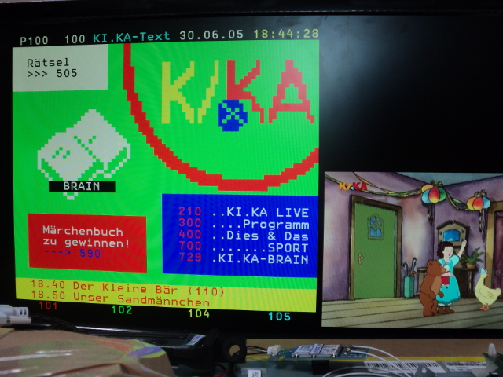
PAT Mode

Slide 9
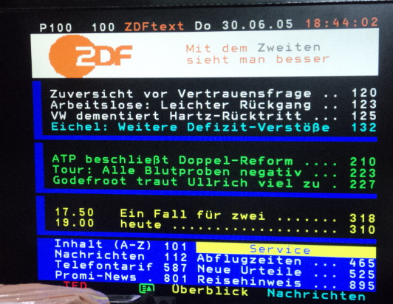
Text Mode

Slide 10
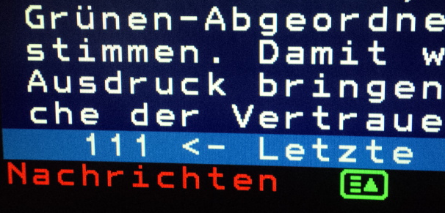
Flof and Top..

Slide 11
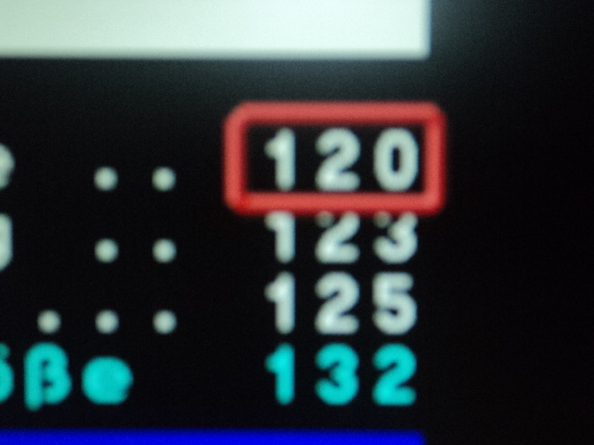
Contd..

Slide 12
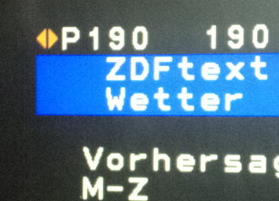
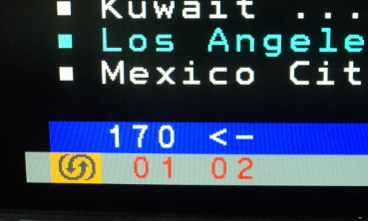
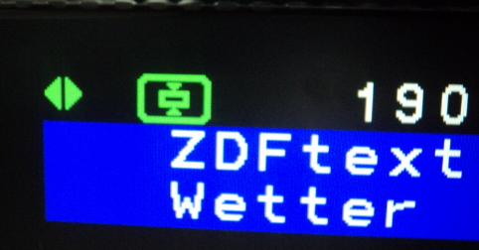
Contd..

Slide 13
MHEG
MHEG-5 is an open standard, TV middleware or application programme interface (API) – designed to allow broadcasters to provide interactive/hybrid services beyond broadcast video that appeal to a wide audience cost-effectively.
MHEG-5 can be used to deploy a wide variety of applications; from basic “red button” services to platform wide EPGs, enhanced Teletext and multi-screen applications.
The MHEG-5 is simple and its client software can be implemented in a wide range digital TV receivers. The client software consists of an MHEG-5 that interprets MHEG-5 applications and presents information delivered to it via a broadcast file system or via a ‘return channel’.

Slide 14
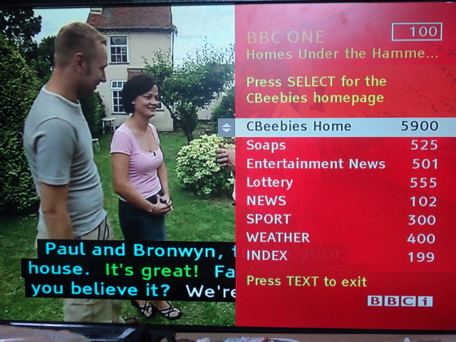
MHEG – Entered Mode

Slide 15
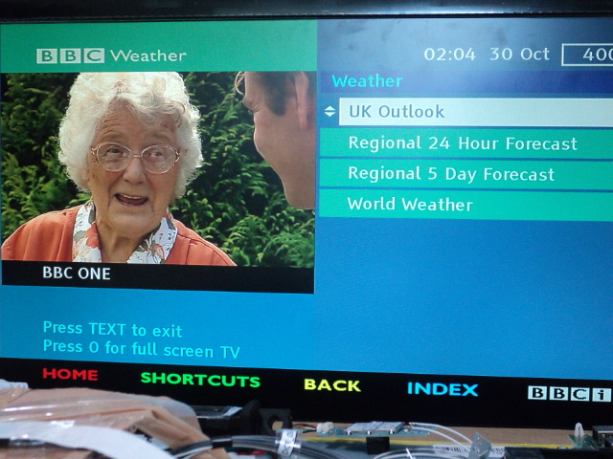
MHEG – Full Mode

Slide 16
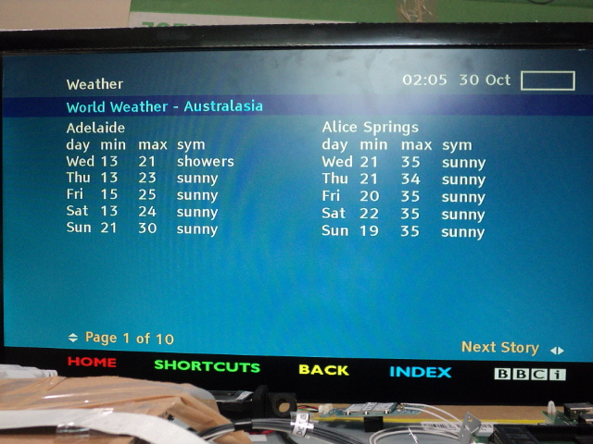
Contd..

Slide 17
MHP
Multimedia Home Platform (DVB-MHP) is an open middleware system standard designed by the DVB project for interactive digital television.
The MHP enables the reception and execution of interactive, Java-based applications on a TV-set and can be delivered over the broadcast channel, together with audio and video streams.
These applications can be information services, games, interactive voting, e-mail, SMS or shopping.
The core of MHP has also been adopted in a compatible manner by non-DVB systems (i.e. ATSC, ARIB, CABLELABS, Blu-ray Disc Association) through the development of GEM (Globally Executable MHP)

Slide 18
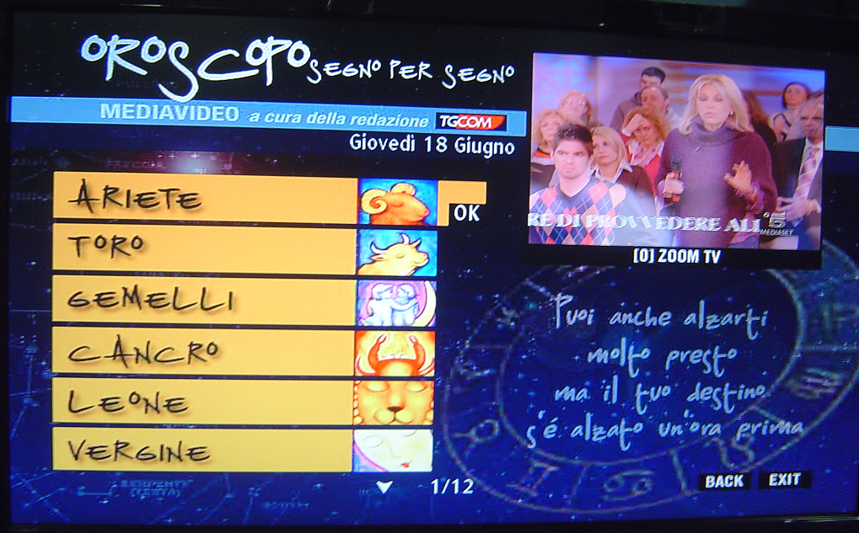
Contd..

Slide 19

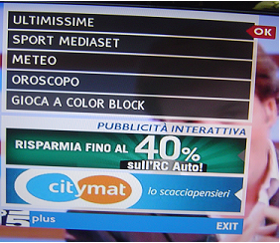
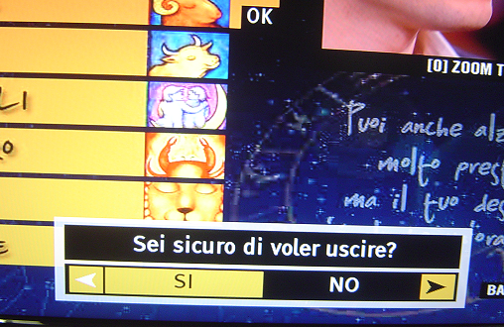
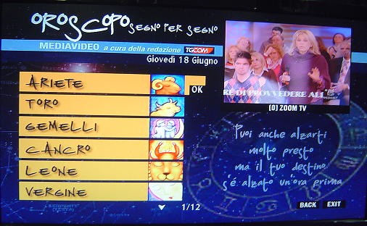
Launching MHP Through Auto Start
<RED> key
Wait for few Minutes
Select Any Application
<RETURN> or
<EXIT> Key

Slide 20
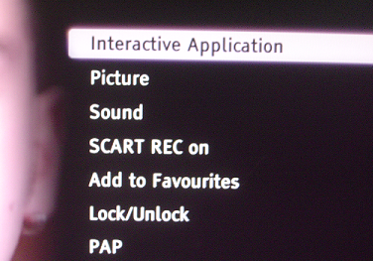
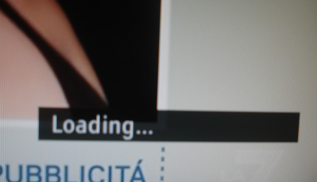
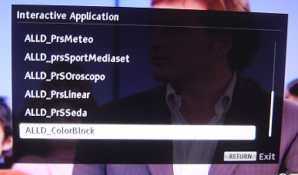
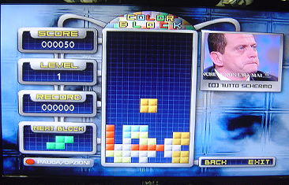
Launching MHP from Options Menu:
<SELECT> key
<SELECT> key

Slide 21
Difference between subtitle & closed caption
The main difference is that closed captioning is specifically designed for hearing impaired viewers.
They are called "closed" because they are activated when the viewer requests them.
The captions usually include a full audio transcription, such as references to background noise and natural sounds (a dog barking, a door slamming, birds singing etc), music, as well as conversation.
usually only include a transcription of speakers/conversation and they are often permanently on.
Subtitles are often used to translate conversation into other languages, can be used for a specific part of a video where regional dialect/accents/language make the speaker difficult to understand.

Slide 22
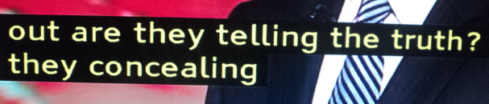
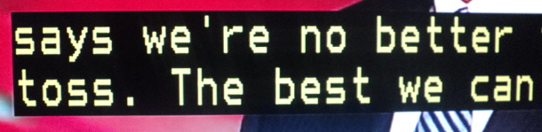
DVB Subtitles and Teletext Subtitles

Slide 23
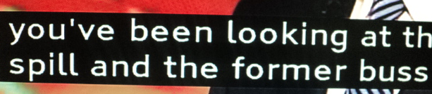
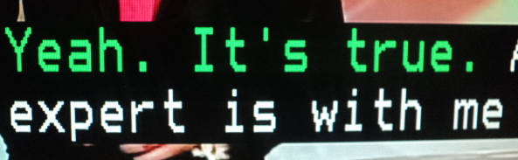
Contd..

Slide 24
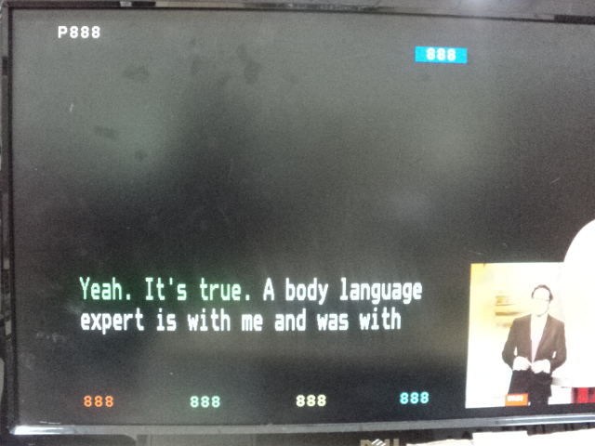
Contd..

Slide 25
Motion flow
Motion-flow is basically new frames inserted between standard frames to create a smoother images.
To improve picture quality
To improve picture clarity in fast moving scenes
To reduce motion blur.
Motion Flow Technology is now being integrated into Sony BRAVIA LCD TVs at 120Hz and 240Hz.
The difference between 120Hz and 240Hz are quite substantial. The level measured is the televisions refresh rate.
So a 240Hz LCD TV will refresh images twice as many times as a 120Hz LCD TV.

Slide 26
CAM
Conditional Access is the protection of content by requiring certain criteria to be met before granting access to this
This is achieved by a combination of scrambling and encryption.
Scrambling :
The data stream is scrambled with an 8-byte secret key, called the control word.
The control word is generated automatically in such a way that successive values are not usually predictable.

Slide 27
Contd..
Encryption
is used to protect the control word during transmission to the receiver
Control word is encrypted as an Entitlement Control Message (ECM).
The CA subsystem in the receiver will decrypt the control word only when authorised to do so; that authority is sent to the receiver in the form of an Entitlement Management Message (EMM).
The EMM are specific to each subscriber, as identified by the smart card in his receiver.

Slide 28
Contd..
CAM Port in TV
Encryption Algorithm
TV
CAM Device
CAM Card
Private Key
Broadcaster
Public Key

Slide 29
Broadcasting
Satellite
MUX
Audio
ES
PES
TV
Tuner
Prog 1
Video
ES
PES
TS
Subtitle
ES
PES
Tuner
MUX
DMUX
PES
Packets from Air will be combined together to get SECTION
Section

Slide 30

Q&A

Slide 31


